Slide 1
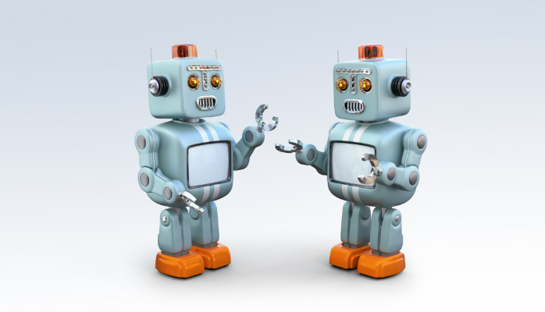
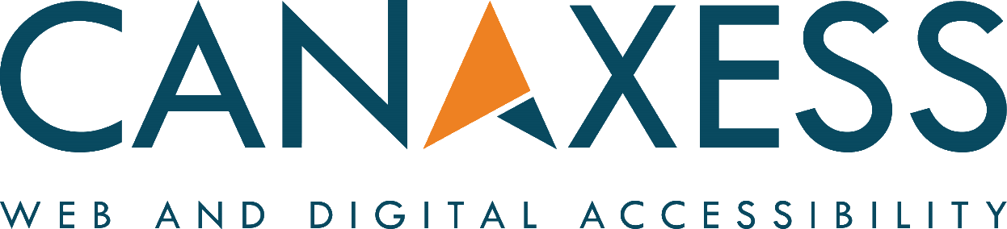
Building accessible chatbots
6 accessibility principles for better design

Slide 2

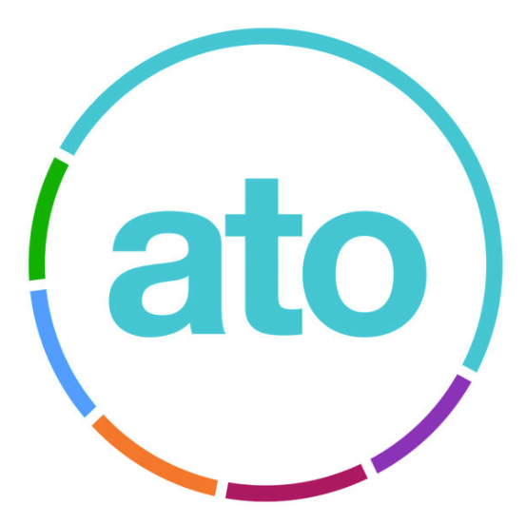


Embracing chatbots
Chatbots are being embraced by many government departments throughout Australia including the Museum of Australian Democracy, Australian Taxation Office and also private organisations including Telstra and the Commonwealth Bank

Slide 3
What is a chatbot
It's a program which sits on a website, when activated provides human like responses to questions from the user
They work over many channels
- Facebook
- Skype
- Websites

Slide 4
Caution before use
A well created accessible website can be quickly undermined by an inaccessible chatbot. Principles for accessible design need to be followed

Slide 5
6 accessibility principles
Choose a customisable platform
Ensure conversation history can be navigated
Make the conversation history identifiable
Ensure messages are announced
All rich media must be accessible
Provide a skip link

Slide 6
1. Customisable platform
Many vendors offer chatbot platforms that include controls to make bots work on a website with minimal code
be wary of these controls

Slide 7
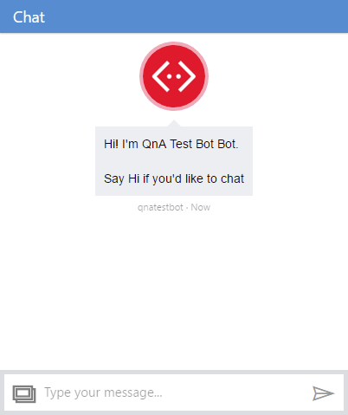
Easy to integrate
Many have poor or non-existent accessibility support
Example. Microsoft bot framework webchat control. If you use this control on your website, it'll mean it's probably not accessible

Slide 8
Confirm accessibility support
Test any pre-built chatbot control thoroughly, it may not provide good accessibility support
Test against web accessibility guidelines
Treat claims of 100% accessibility with caution

Slide 9
A good platform
Will allow you to create your own custom UI in HTML and CSS. The closer you get to creating an interface in HTML and CSS, the more accessible it will be

Slide 10
2. Conversation history
Every message must be reachable from the keyboard, some users may use not use a mouse

Slide 11
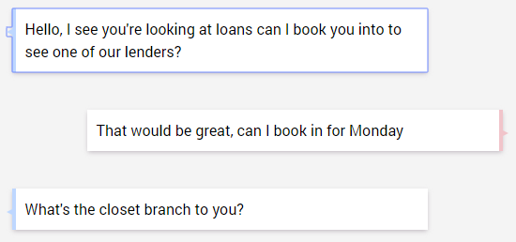
Keyboard focus
Add tabindex=0 on every message. This allows a keyboard user to tab through the entire conversation history

Slide 12
3. Identifiable conversation
Every message in the conversation must be identifiable. Identify messages from the user and messages from the bot
aria-label="the bot said"
aria-label="you said"

Slide 13

How it looks so far
<div tabindex="0" aria-label="The bot said">
What can I help you with?
</div>
"The bot said what can I help you with"

Slide 14
4. Announce the updates
Use the aria-live attribute to audibly announce new messages

Slide 15
Announcing new messages
When the container has text added to it, only the new text is announced by the screen reader
<div class="conversation-body" aria-live="assertive">
<div tabindex="0" aria-label="The bot said">What can I help you with?</div>
</div>
"What can I help you with?"

Slide 16
Prioritise announcements
A value of assertive announces updates immediately through the screen reader, a value of polite pauses until all other audio has ended
<div class="conversation-body" aria-live="assertive">

Slide 17
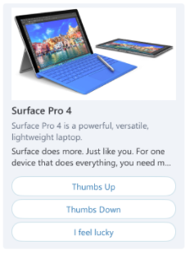
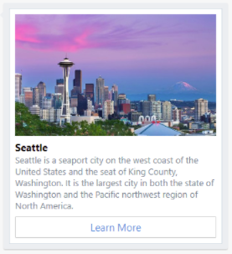
5. Rich media messages
Several bot platforms can return rich media including images, audio and buttons in addition to plaintext

Slide 18
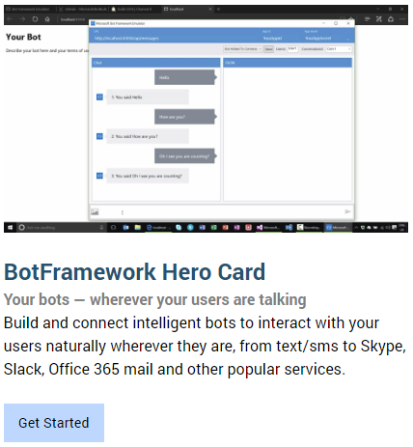
Rich media messages
Need to be made accessible
Images have appropriate ALT text
Headings are properly structured
Buttons are keyboard accessible
Logical focus order

Slide 19
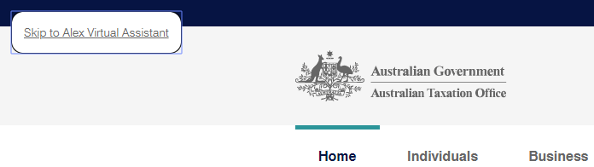
6. Provide a skip link
Allow the user to shortcut to the chatbot without having to tab through the whole page

Slide 20
6 principles + more
Adding accessibility features doesn’t end at these 6 principles

Slide 21
Also think about
Conversation is pitched at a suitable age level
Colour contrast
Focus shows the most recent message

Slide 22
Test the results
Test these principles with users to confirm results
Test in browsers
Test different browser versions
Test different assistive technology

Slide 23
Microsoft bot framework
If your skills are .NET based it's one of the better configurable platforms. It supports many channels and plugin services, including intelligence with Cognitive Services

Slide 24
Microsoft bot framework
However avoid using the out-of-the box webchat control provided by Microsoft, as the bots user interface will not be accessible
An accessible UI is achieved by creating your own UI in HTML, CSS, ARIA and Javascript

Slide 25
Get the basics right
Many bot frameworks offer fantastic potential for helping people with disabilities, but if you don’t follow these basic steps all that means little
Before embracing further cutting edge techniques make sure your chatbot is accessible to WCAG 2.0 AA

Slide 26
Voice UI
To support people using voice based interfaces we need to think about building tolerances to handle:
Speech dysfluencies e.g. Stuttering
Accents
English as a Second Language

Slide 27
Everyone benefits
Building tolerances which help people with speech disorders also helps:
People in a noisy environment
People with temporary impairments
People who are distracted

Slide 28
Examples of good bot design
Australian Federal Government
- Australian Tax Office (Alex)
- IP Australia

Slide 29
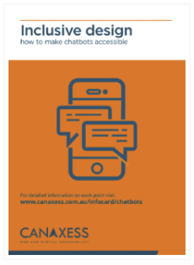


For more information
Get a free information card from www.canaxess.com.au/infocard/chatbots
ross.mullen@canaxess.com.au
MrRossMullen
github.com/canaxess/fenton

